Slide 1

An Introduction to Relational Databases

Slide 2
What will you learn ?
Data model
Relational Model Concepts
An Informal Look at the Relational Model
Relvars
Optimization
Data Dictionary
Base Relvars and Views
Transactions

Slide 3
1. Data model
A data model is an abstract, self-contained, logical definition of the objects, operators.
  Objects: model the structure of data (e.g., data type, relationships, and constraints).
  Operators : model the behavior of objects.
A database schema is the description of a database using a data model.
Data modeling is the process of creating a data model for an application.

Slide 4
Categories of Data Models
Based on level of data abstraction
Conceptual level (high-level)
  Provide concepts that are close to the way many users perceive data.
  Approaches: Entity-relationship (ER) model, semantic object model, etc.
  Semantic Object Model. Define semantic objects; Use semantic object diagrams to build data models;
Logical level (DBMS level)
  Provide concepts that are close to the way data is organized but still may be understood by end users.
  Approaches: relational, object-oriented, network, and hierarchical model.
Physical level (low-level)
  Provide concepts that describe the details of how data is stored in the computer.

Slide 5
2. Relational Model Concepts
Relational data model: represents the data in a database as a collection of relations (tables).
  First introduced by Codd in 1970
  Based on mathematical notion of domain and relation
  A relation can be easily represented in a table format although they are not the same.
Relational data model is just one data modeling technique for a database.
Relational systems are based on the relational model.

Slide 6
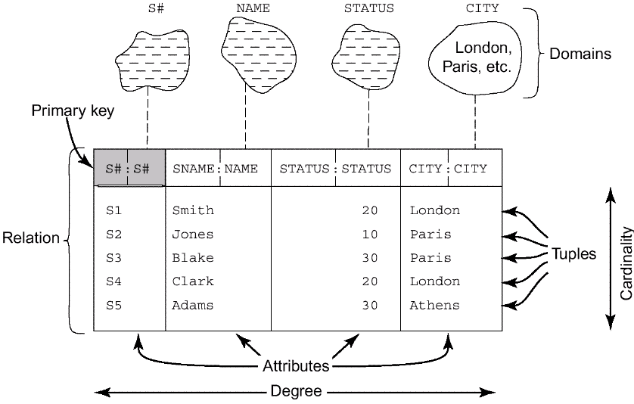
Relational Model Concepts(Continued)
Fig. 5.1 Structural terminology
P111

Slide 7
Relational Model Concepts(Continued)
Attribute (field or column)
Relation (table)
  e.g., person, emp ,course, etc.
Tuple (record or row)
  The set of attribute values for an object.
Cardinality
  The number of tuples

Slide 8
Relational Model Concepts(Continued)
Degree
  The number of attributes
Domain (type with some constraints)
  The set of all possible values an attribute can have.
  It is a description of the format (type, length, etc.) and the semantics of an attribute.
  Domains are data types, operators
  Domains are object classes

Slide 9
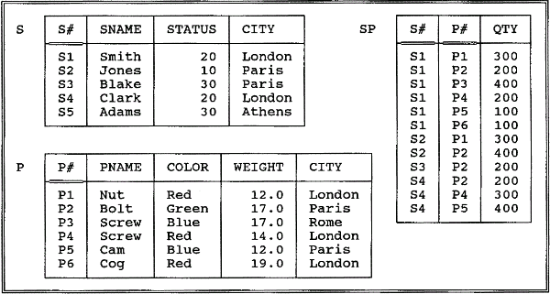
Relational Model Concepts(Continued)
Fig. 3.8. The Suppliers and parts database(sample values)
P111

Slide 10
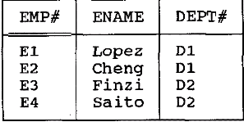
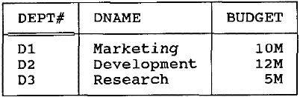
Relational Model Concepts(Continued)
Primary key
  is an attribute, or a collection of attributes, whose values uniquely identify each tuple in a relation.
Relationship
  is the related information between relations. Relationship can be represented by common attribute (s) between relations.
Foreign key
  is the common attribute (s) between relations and that is a primary key in other related relation.
Foreign Key
Primary Key

Slide 11
Relational Model Concepts(Continued)
A precise definition of the term relation
  Given a collection of n types or domains Ti (i = 1, 2, …, n), not necessarily all distinct, r is a relation on those types if it consists of two parts, a heading and a body, where:
    The heading is a set of n attributes of the form Ai:Ti, where the Ai (which must all be distinct) are the attribute names of r and the Ti are the corresponding type names (i = 1, 2, …, n);
    The body is a set of m tuples t, where t in turn is a set of components of the form Ai:vi in which vi is a value of type Ti—the attribute value for attribute Ai of tuple t (i = 1, 2, …, n).
  The values m and n are called the cardinality and the degree, respectively, of relation r.
  Table=relation?

Slide 12
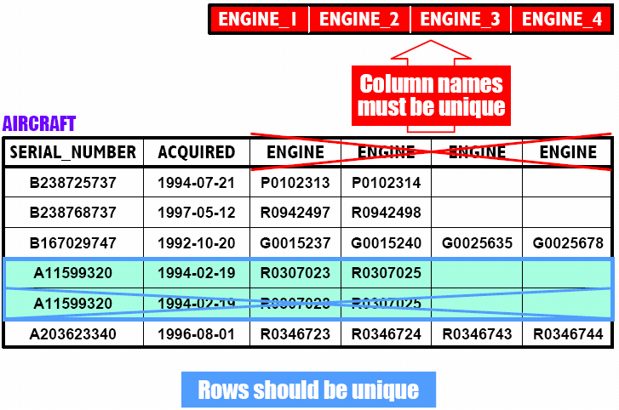
Properties of relations
  1 There are no duplicate tuples; Column names must be unique;

Slide 13
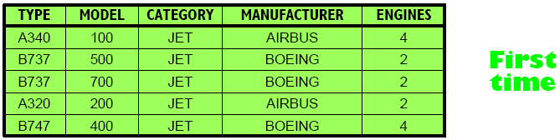
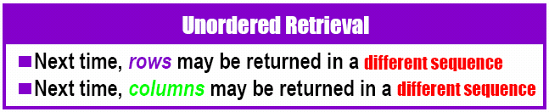
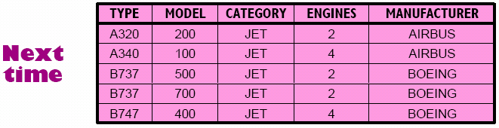
Properties of relations
  2 Tuples are unordered, top to bottom;
  3 Attributes are unordered, left to right;

Slide 14
Properties of relations
  4 Each tuple contains exactly one value for each attribute.
 A relation that satisfies this fourth property is said to be normalized, or equivalently to be in first normal form.

Slide 15
3. An Informal Look at the Relational Model
Structural aspect: tables
Integrity aspect: Those tables satisfy certain integrity constraints (IC)
Manipulative aspect: operators
  restrict, project, and join.

Slide 16
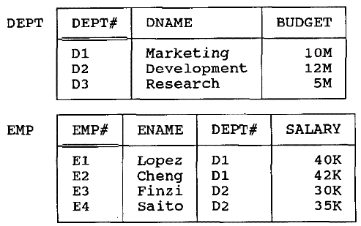
Structural aspect: Table
Fig. 3.1 The dept and emp relation in a table format

Slide 17
Structural aspect: Table (Continued)
Tables are the logical structure in a relational system, not the physical structure.
At the physical level, in fact, the system is free to store the data any way it likes—using sequential files, indexing, hashing, pointer chains, compression, etc.
The Information Principle: The entire information content of the database is represented in one and only one way, namely as explicit values in column positions in rows in tables. There are no pointers connecting one table to another.

Slide 18
integrity constraints
Primary Key constraints
  Primary key value must be unique for every tuple in a relation
  No primary key value can be NULL
Domain constraints
  The constraints on the domain of attributes.
  (CHECK clause)
Referential integrity constraint
  Foreign key constraint, e.g., A tuple in one relation that refers to another relation must refer to an existing tuple in that relation.
  To maintain the consistency among tuples of the two related relations.
Other constraints: functional dependency, assertions, triggers.

Slide 19
operators
The property of relational operators
Closure property:The result of relational operations is table(set at a time).
Nested expressions:The output from one operation can become input to another.
Relational languages are nonprocedural, on the grounds that users specify what, not how—i.e., they say what they want, without specifying a procedure for getting it. (automatic navigation)

Slide 20
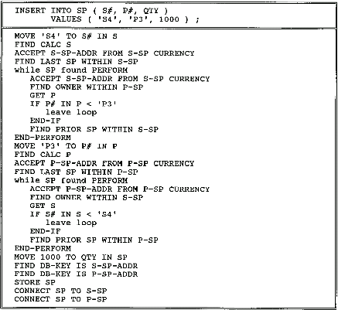
Fig 3.5 Automatic vs. manual navigation

Slide 21
4. Relvars
Relvar:relational variables
  E.g. Customer,Product,Ptype,DEPT,EMP
The values of Relvar is relation values.
The relation values is different at different times.
delete →relational assignment operation

Slide 22
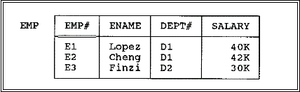
Relations and Relvars (Continued)
Relational assignment
  EMP:=EMP MINUS (EMP WHERE E#=“E4”);
  DELETE EMP WHERE E#=“E4”;

Slide 23
5. Optimization
Relational systems are sometimes said to perform automatic navigation.
For each relational request from the user, it is the job of the optimizer to choose an efficient way to implement that request.
e.g. RESULT:=(EMP WHERE EMP#=‘e4’){SALARY};
  two ways of performing the necessary data access:
  By doing a physical sequential scan of (the stored version of) relvar EMP until the required data is found;
  If there is an index on (the stored version of) the EMP# column, use that index and going directly to the required data.

Slide 24
Optimization (Continued)
The basis of considerations of optimization:
  Which relvars are referenced in the request;
  How big those relvars currently are;
  What indexes exist;
  How selective those indexes are;
  How the data is physically clustered on the disk;
  What relational operations are involved;

Slide 25
6. The Catalog (or Data Dictionary)
contains detailed information (sometimes called descriptor information or metadata) regarding the various objects that are of interest to the system itself.
The place where
  all of the various schemas (external, conceptual, internal)
  all of the corresponding mappings (external/ conceptual, conceptual/internal)
  are kept.
  Optimizer uses… security subsystem use…

Slide 26
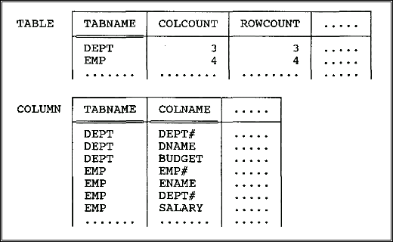
The Catalog…
The catalog itself consists of system relvars.
Fig. 3.6 Catalog for the departments and employees database

Slide 27
The Catalog…
users can interrogate the catalog in exactly the same way they interrogate their own data.
  E.g.
  1.what columns relvar DEPT contains?
  (COLUMN WHERE TABNAME=‘DEPT’){COLNAME};
  2.Which relvars include a column called EMP#?
  (COLUMN WHERE COLNAME=‘EMP’){TABNAME};
  3.What does the following do?
  ((TABLE JOIN COLUMN)
  WHERE COLCOUNT<5){TABNAME,COLNAME};

Slide 28
7. Base Relvars and Views
P71~75
The original (given) relvars are called base relvars, and their relation values are called base relations (real relvar);
A relation that is or can be obtained from those base relations by means of some relational expression is called a derived or derivable relation.

Slide 29
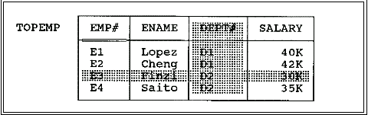
View
A view is a derived relvar(virtual relvar).
e.g. CREATE VIEW TOPEMP AS
(EMP WHERE SALARY >33K){EMP#,ENAME,SALARY};
Fig. TOPEMP as a view of EMP(unshaded portions)

Slide 30
View (Continued)
A view can be derived from several tables or views.
  E.g.
  CREATE VIEW JOINEX AS
  ((EMP JOIN DEPT)
  WHERE BUDGE>7M){EMP#,DEPT#};

Slide 31
View (Continued)
The view is effectively just a window into the underlying base relvar.
Any changes to that underlying relvar will be automatically and instantaneously visible through that window.

Slide 32
View (Continued)
Changes to TOPEMP will automatically and instantaneously be applied to relvar EMP.
e.g.
(TOPEMP WHERE SALARY<42k){EMP#,SALARY}
((EMP WHERE SALARY>33K){EMP#,ENAME,SALARY})
WHERE SALARY<42k){EMP#,SALARY}

Slide 33
View (Continued)
e.g.
DELETE TOPEMP WHERE SALARY<42k;
DELETE EMP
WHERE SALARY>33K AND SALARY<42K;

Slide 34
8. Transactions
A transaction is a logical unit of work, typically involving several database operations.
BEGIN TRANSACTION, COMMIT, and ROLLBACK

Slide 35
An example of transaction
BEGIN TRANSACTION
…
/*读出帐户Acct1的余额Balance1*/
EXEC SQL SELECT balance
INTO :Balance1
FROM Accounts
WHERE AccountNo=:Acct1；
/*从帐户Acct1中减去金额Amount*/
EXEC SQL UPDATE Accounts
SET balance=balance-:Amount
WHERE AccountNo=:Acct1；
IF （Balance1<Amount）
{
printf（“金额不足，不能转帐！”）；
/*恢复事务，撤消所有操作*/
EXEC SQL ROLLBACK；
}
ELSE
{
/*对帐户Acct2增加金额Amount*/
EXEC SQL UPDATE Accounts
SET balance=balance+:Amount
WHERE AccountNo=:Acct2；
EXEC SQL COMMIT； /*提交事务*/
} …

Slide 36
property of transactions
Atomic:Transactions are guaranteed either to execute in their entirety or not to execute at all.
Durability: Once a transaction successfully executes COMMIT, its updates are guaranteed to be applied to the database, even if the system subsequently fails at any point.

Slide 37
property of transactions (Continued)
Isolation: Database updates made by a given transaction T1 are not made visible to any distinct transaction T2 until and unless T1 successfully executes COMMIT.
Serialization: The interleaved execution of a set of concurrent transactions produces the same result as executing those same transactions one at a time in some unspecified serial order.

Slide 38
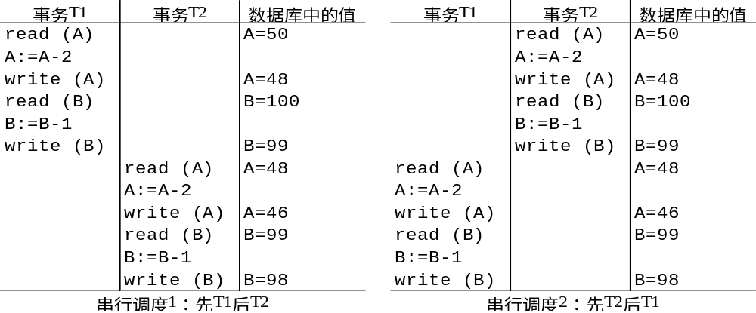
Example
Result:A=46,B=98

Slide 39
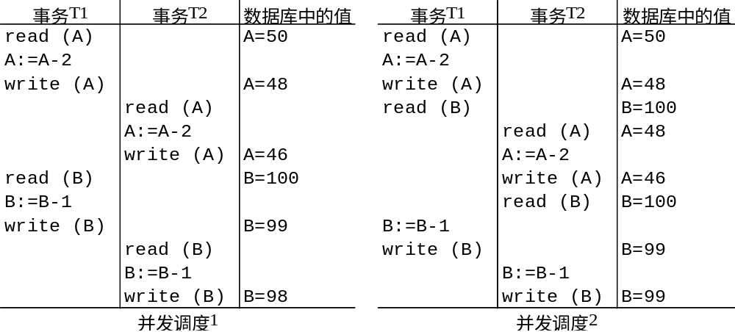
Example…
Result:
A=46,B=98 √
Result:
A=46,B=99 ×

